Slide 1
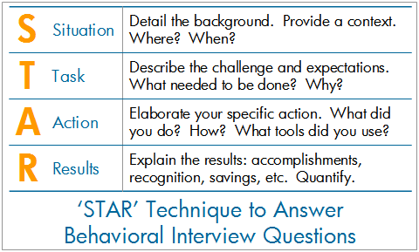
Articulating Your Accomplishments
Source: http://www.rightattitudes.com/2008/07/15/star-technique-answer-interview-questions/

