Slide 1
Navigating ADP Recruitment
Manager Access

Slide 2
ADP Login

Slide 3
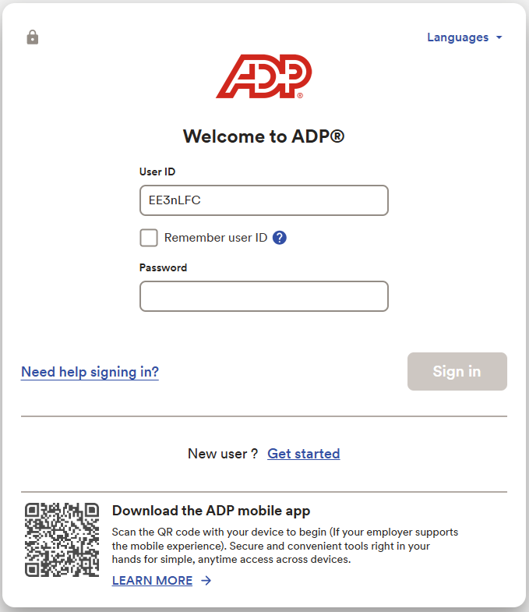
ADP Login
www.workforcenow.adp.com
1. Enter your User ID and click the Next button
Once you click the Next button the Password field will appear
2. Enter your Password and click the Sign In button
Once you Sign in
ADP will send you a verification code
3. Enter the verification code
If you forget either your User ID or Password, select the link “Need help signing in?”
1
2

Slide 4
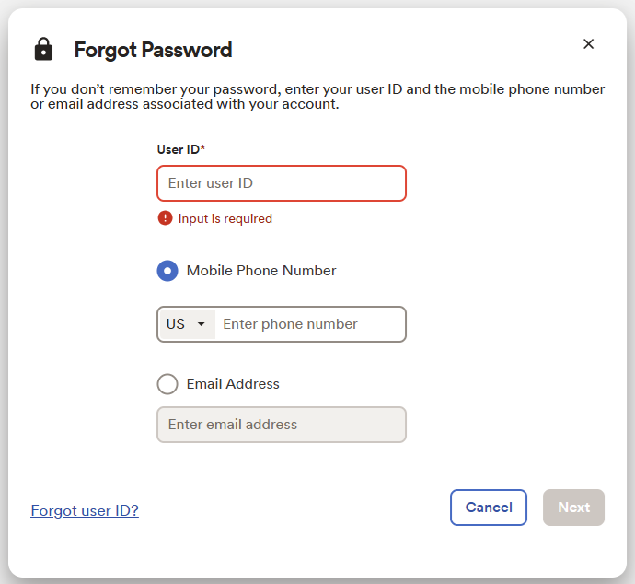
Need Help Signing In Window
Once you click on “Need help signing in?”
A new window will open- follow prompts for Forgot Password or
Click the link Forgot user ID? And follow prompts

Slide 5
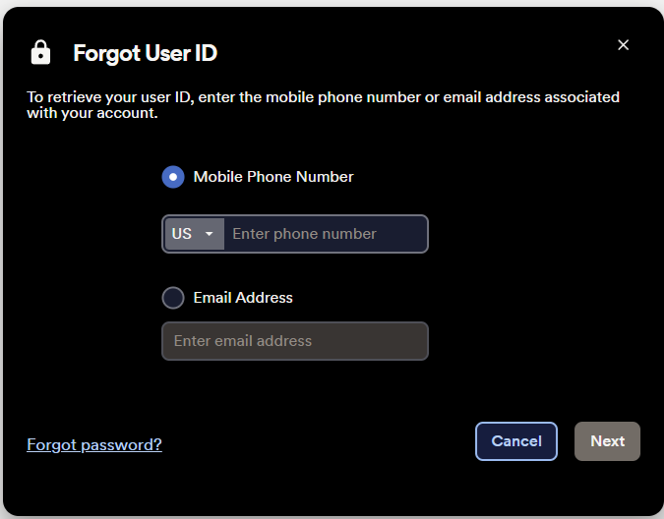
Need Help Signing In Window
Once you click on “Forgot User ID?”
A new window will open- follow prompts for Forgot User ID
To retrieve your user ID, enter the mobile phone number or email address associated with your account.

Slide 6
ADP Home Page
Manager

Slide 7
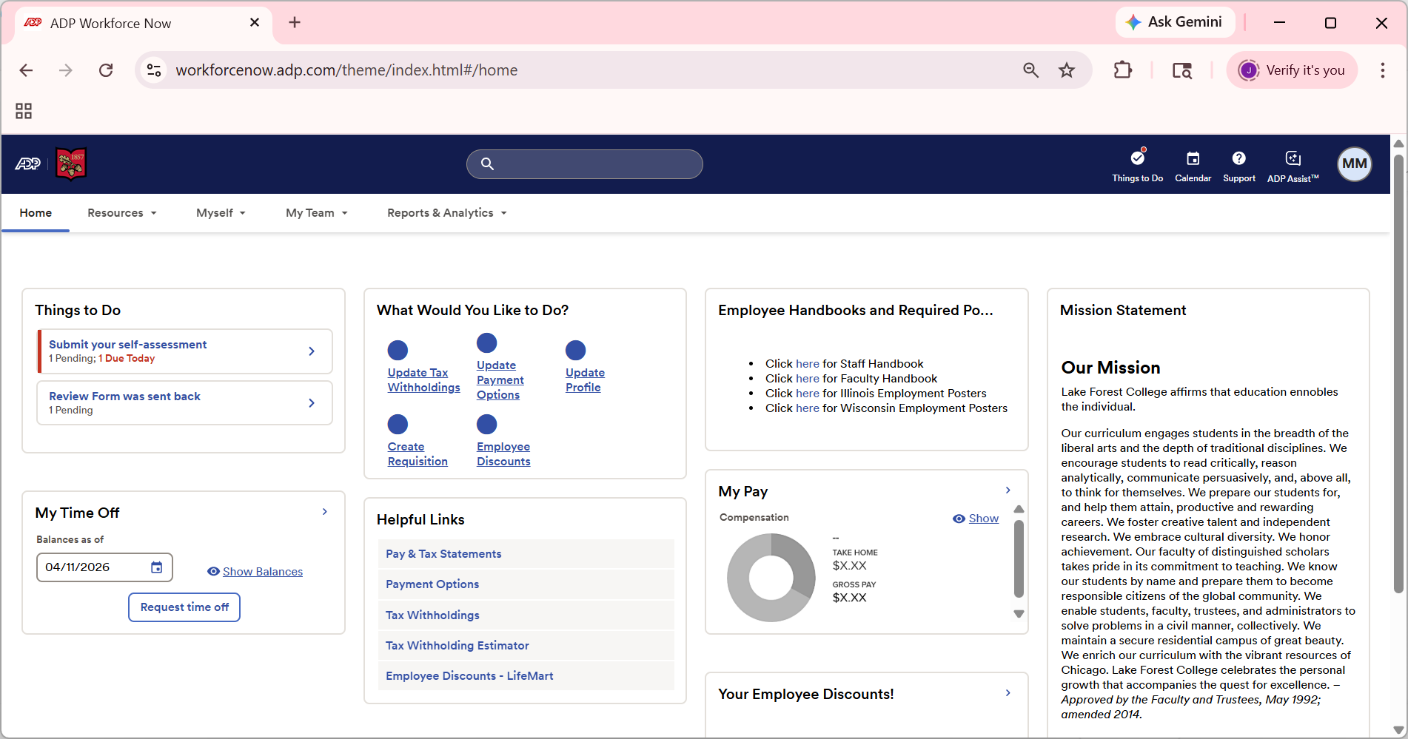
Depending on your access, the tabs on your screen may look different.
To view your team information, click the tab “My Team” to view your own information click the tab “Myself”

Slide 8
To View the Recruitment Dashboard

Slide 9
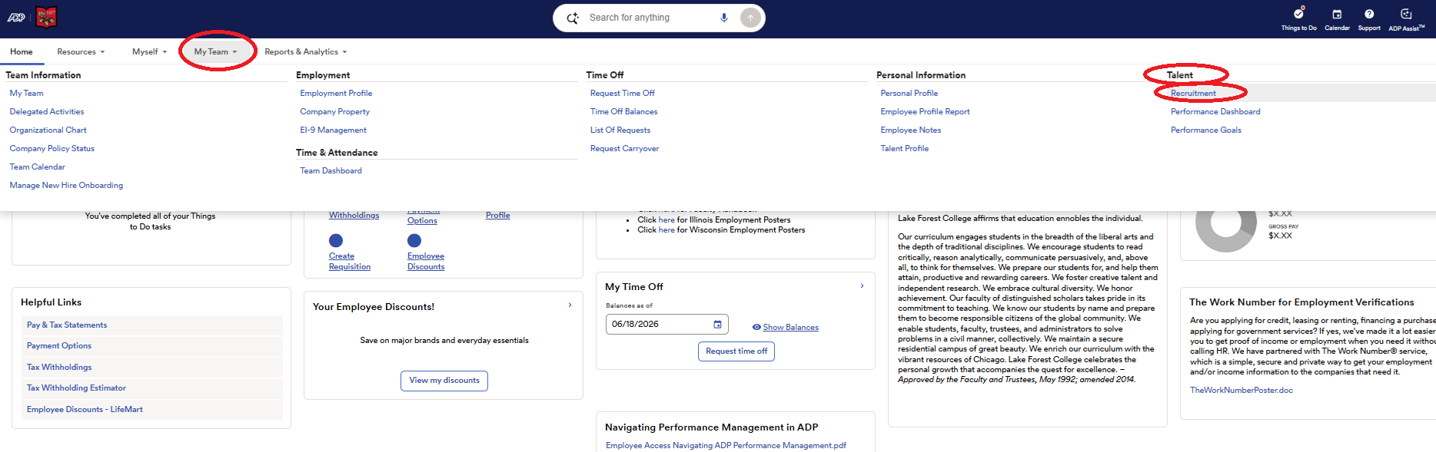
Click the tab “My Team” to view the menu options.
Navigate to the section call Talent
From the Talent menu, select Recruitment

Slide 10
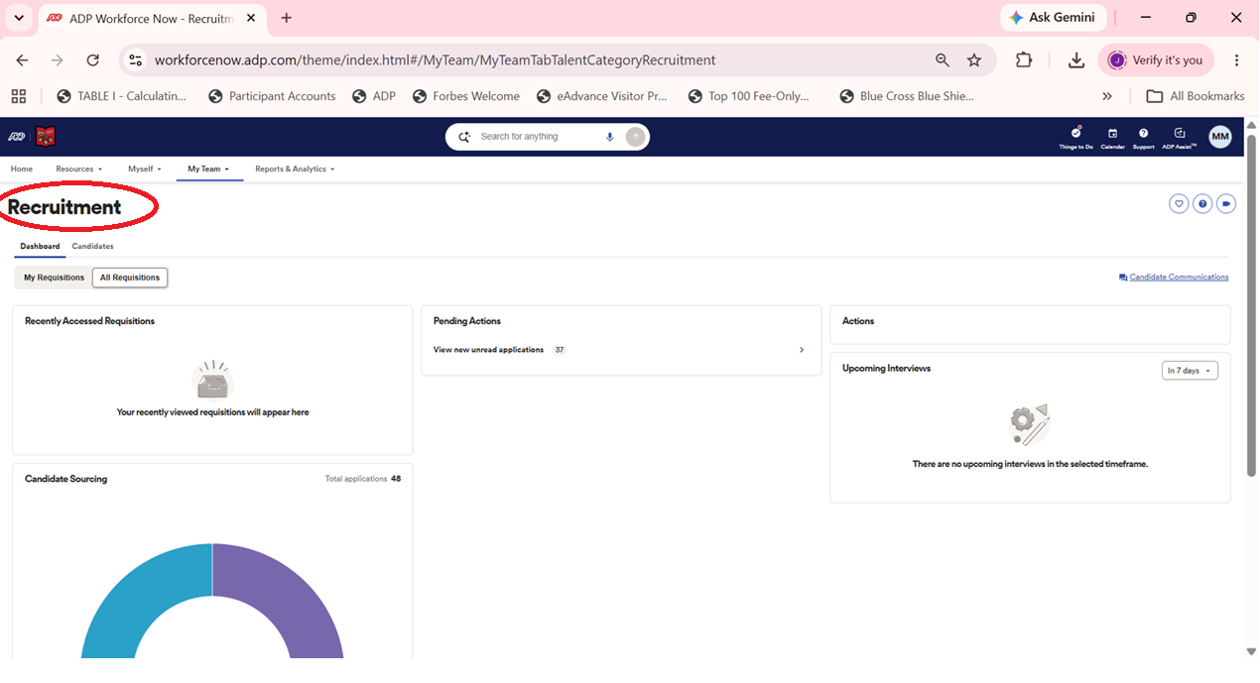
Now you are in the Recruitment dashboard.

Slide 11
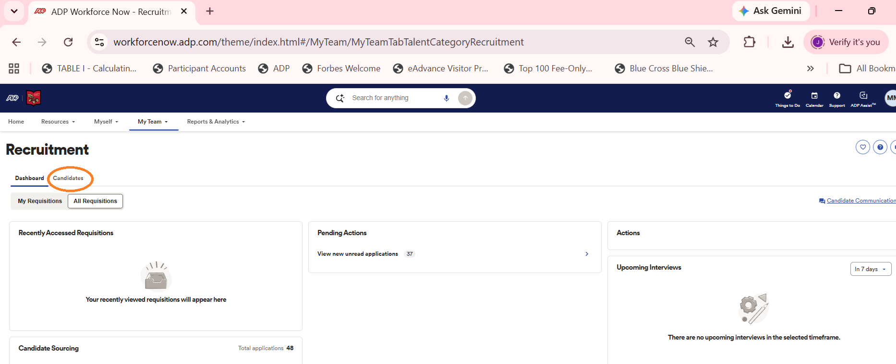
To View Candidate Applications and Resumes
Click on the Candidates Tab

Slide 12
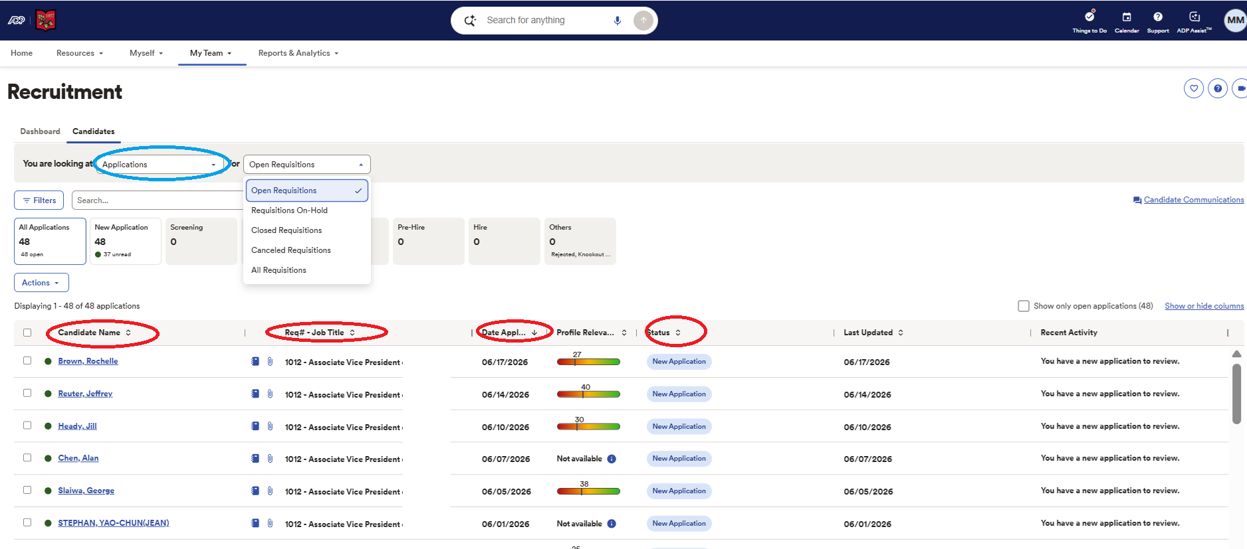
Currently, we are only using ADP as a repository for Applications and resumes.
Eventually, we will move into workflows and communicating with candidates via ADP.
In the Candidates Tab, you will be able to see the Applications
You can view all Requisitions you have access to and can filter by status.
X
Do not use
To access an application, click the link on the candidate name

Slide 13
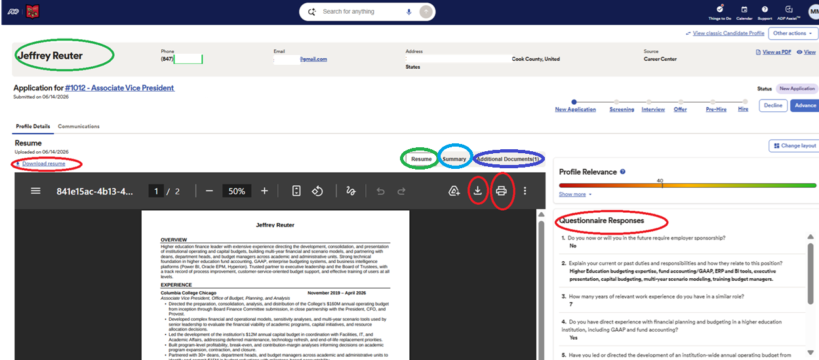
Once you click the link on the candidate name, you will be in the Candidate Profile.
Here you will see: Resume, Application and Responses to Screener Questions and you will be able to download, print and view the candidate’s information.
Candidate name
PDF file view
Requisition/Position Name
Click these tabs for additional information
XXXXXXXXXXXX
XXXXXXXXXXXX
XXX
Do not use
Review responses to screener questions
Download
resume
Print resume
We want to slowly ease users to using the recruitment module so certain features are not being used right now. Eventually, we will move into workflows and communicating with candidates via ADP.

Slide 14
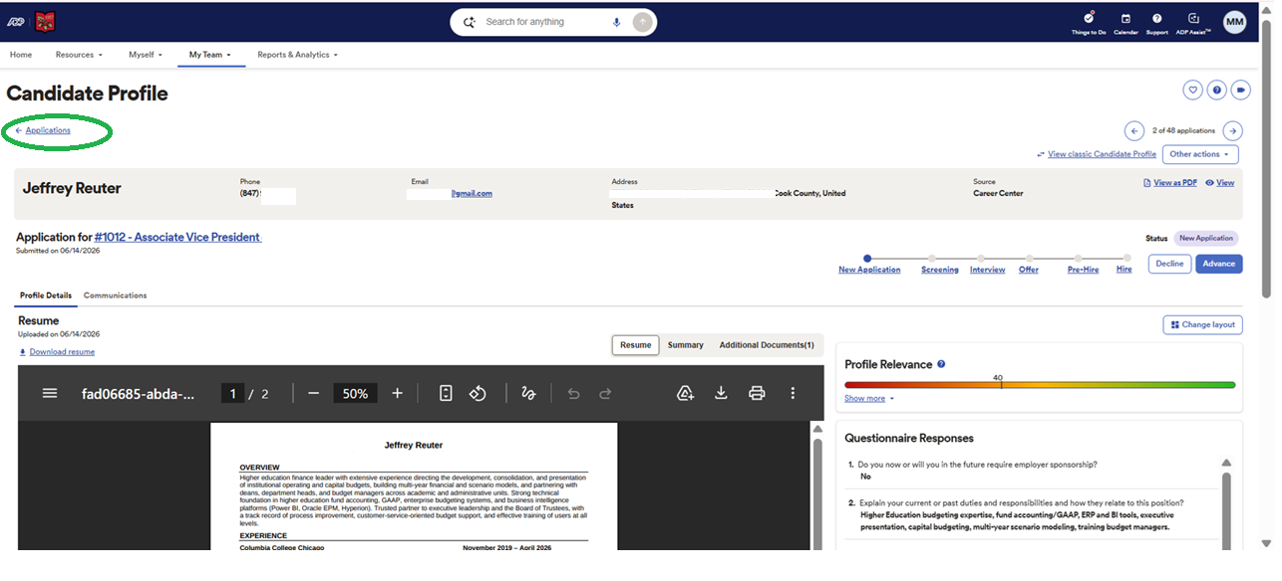
When you are done viewing this candidate profile, to return to the Applications, click on the Applications link.
As we introduce more features to use, we will cover Reporting & Analytics in another training. Reporting & Analytics offers you the ability to report. This is for advanced users with many requisitions.

Slide 15
Useful Information

Slide 16
What to do with the candidate applications/resumes?
For now, managers will use the ADP Recruitment module as a repository for collecting and tracking resumes.
Managers will use the ADP Recruitment module for viewing, downloading and printing resumes.
Managers should continue to follow their current processes for scheduling phone screens and interviews. These features are not yet being used in ADP.
Managers should continue to communicate with candidates via their lakeforest.edu email or via phone.

Slide 17
Where are candidates sourced from?
ADP Career Center: Lake Forest College Career Center
The job postings get picked up as follows:
  *Indeed (gets picked up from the ADP Career Center)
  *Inside Higher Ed Job Board (gets picked up by the IHE job board web scraping process)
  *Lake Forest College LinkedIn Jobs page (gets picked up from the ADP Career Center)
The job postings to the job boards can take up to 24 hours from posting to ADP Career Center for update
Faculty Positions also appear on the Higher Ed Job Board.

Slide 18
Can I post my open position to my network or other job boards?
Yes, please make sure to route candidates to the Lake Forest College Career Center.
Important Notes about job postings to other job boards:
The job posting must include the salary range and benefit information for the position.
For now, please remove any DEI statements.

Slide 19
Thank You!

